Slide 1
SD2231 – Lab 2 Group 7 Lateral slip estimation
Alessandro Riva
Tawsiful Islam

Slide 2
Our unique feature
Biggest issue with the integrating the lateral acceleration is that it integrates from the beginning of the simulation before actual test drive.
Solution: Activate the integral from the time instance the steering angle is large enough.
Estimating the lateral states are interesting when the slip is large, which cannot happen when there is no steering input.

Slide 3
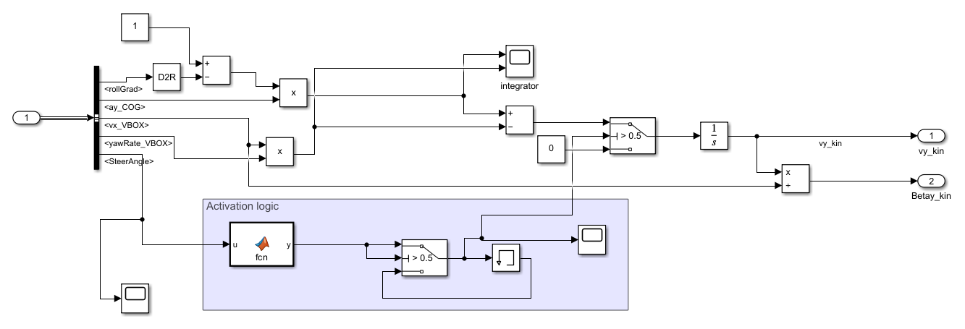
Our unique feature

Slide 4
Our most difficult part
Tuning parameters (like Cf & Cr), and process & measurement noise was the most difficult process.
A lot of manual tuning to make sure it works well for all test drives.
Difficult to implement the resetting feature for the integrator for frequency sweep due to the measurement giving positive integral when it was supposed to be negative.

Slide 5
Our final results
In task 1 we saw that the model estimation was usually good for most simulations after tuning to a tire stiffness of Cf = 200000 and Cr = 250000.
Parameters were chosen so the model estimation was in phase and reasonable amplitude compared to VBOX in frequency sweep.
The integration of the kinetic model drifted already from the beginning which affected the resulting estimation for the washout.
We choose T = 0.8 that gave us overall best MSE

Slide 7
Our final results
In task 2 we implemented the UKF with some tuning on alpha, beta & kappa, whilst tuning the covariance matrices.
Using Cf = 200000 and Cr = 250000, the Q and R matrices did not affect the result that much. Our noises could be reduced by setting suitable parameters for the sigma points and initial state and covariance matrix.
Most difficult to tune in order to reduce noise and spikes in circular driving. Bad estimation on vy but good for slip in general
Settled on x0 = [0.01, 0, 0] and P0= diag(0.001, 0.008, 0.001). Q = diag(0.001, 0.008, 0.001), R = diag(0.01, 0.05, 0.01) alpha = 0.8, beta = 2, and kappa = 0.

Slide 9
Questions!!

